Slide 1
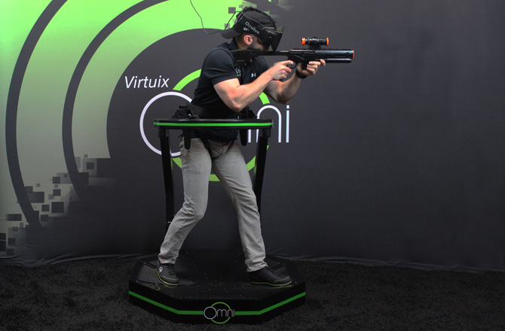
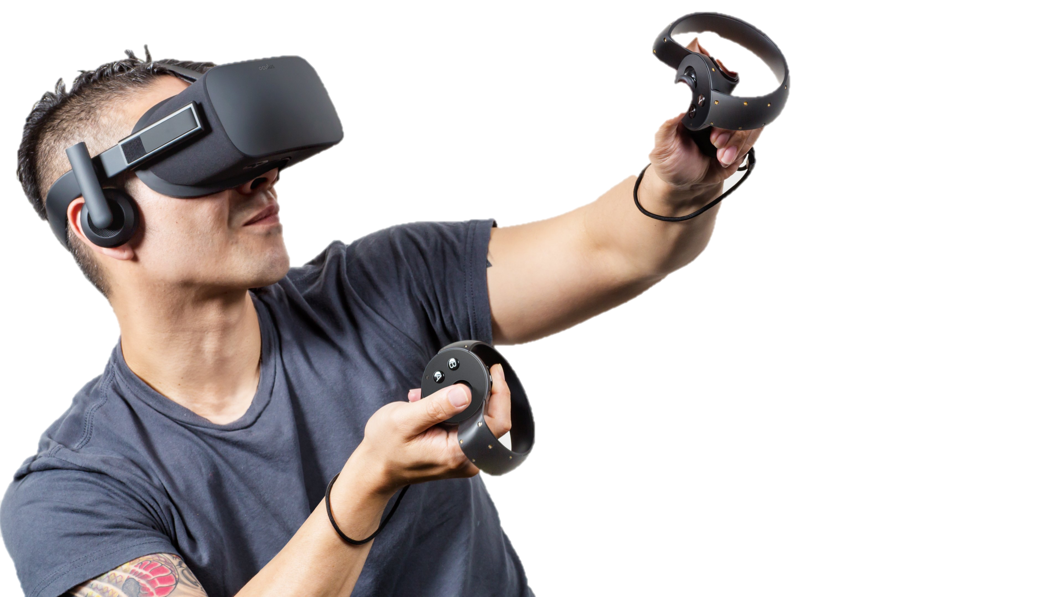
InVirt – Experience Virtual Reality
I see Aliens!
I see enemies!
I see DEAD PEOPLE!
PRITHVI KARAPA, JITESH GUPTA
“In virtual world, lives and feelings are measured not by the distance of miles but by the reality of our desires” - Tony G

Slide 2
PROBLEM
I’ll fb you later!
Bye!
Explore potential of low cost real-time tracking systems
Easy Integration between tracking systems and Virtual Reality applications
Unavailability of motion capture systems to track rotations and fast movements
Why hard for us? : We didn’t know anything about it!
Why hard for in general? : Issues with limiting space, Right fit between Vicon and Kinect
Why Interesting? :
Exploring integrating an efficient tracking system with virtual reality.
It’s super intuitive and a hell lot of fun in a whole different world.
“We’re making a long time bet that immersive and Virtual Reality will become a part of people’s daily life”

Slide 3
SYSTEM DESIGN
IR EMITTERS
END APPLICATION
DATA COLLECTION
AND
RENDERING TOOL
OPTI TRACK MOTIVE
Virtual Reality Application using Unity Game Engine
REFLECTIVE MARKERS
Process data and forwarding to application
IR CAMERAS

Slide 4
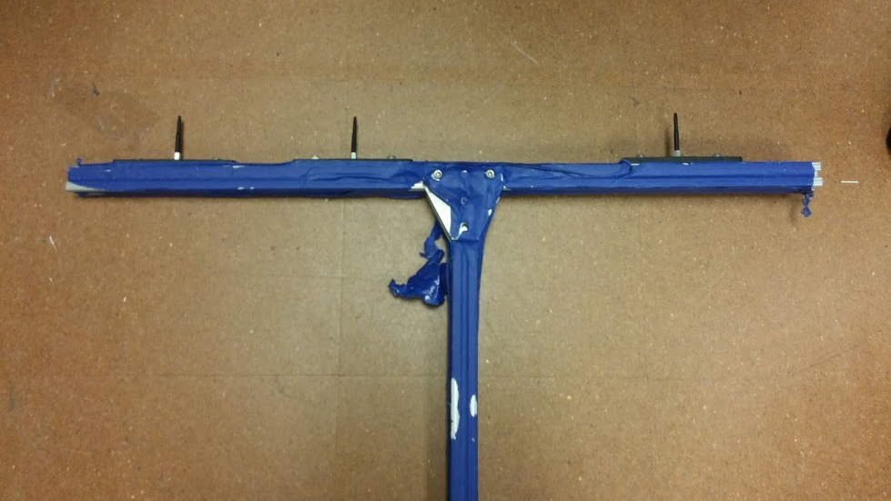
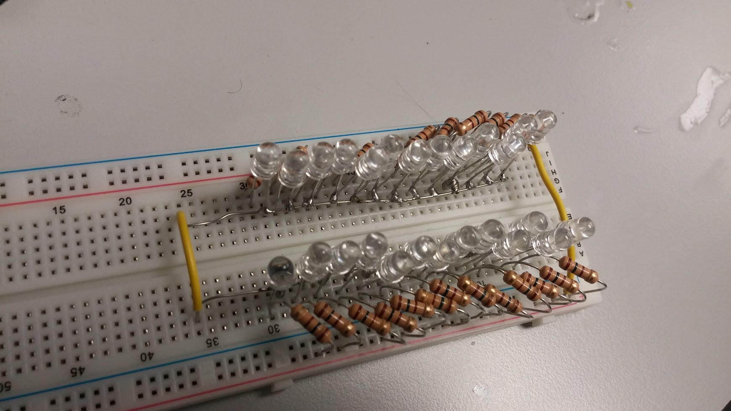
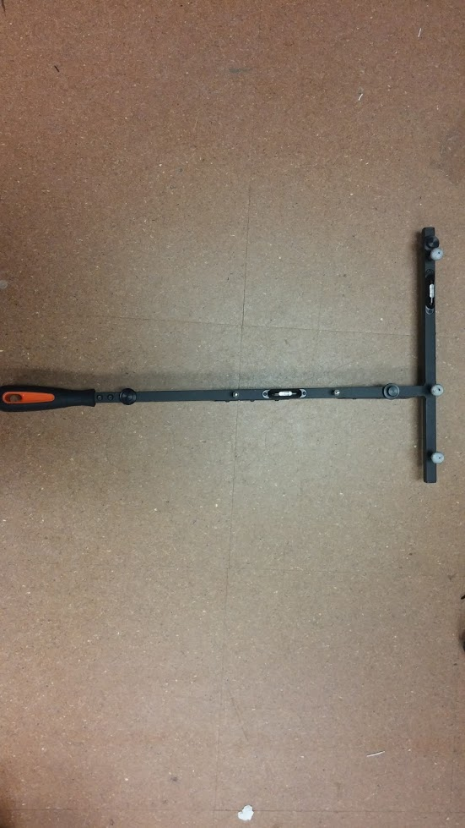
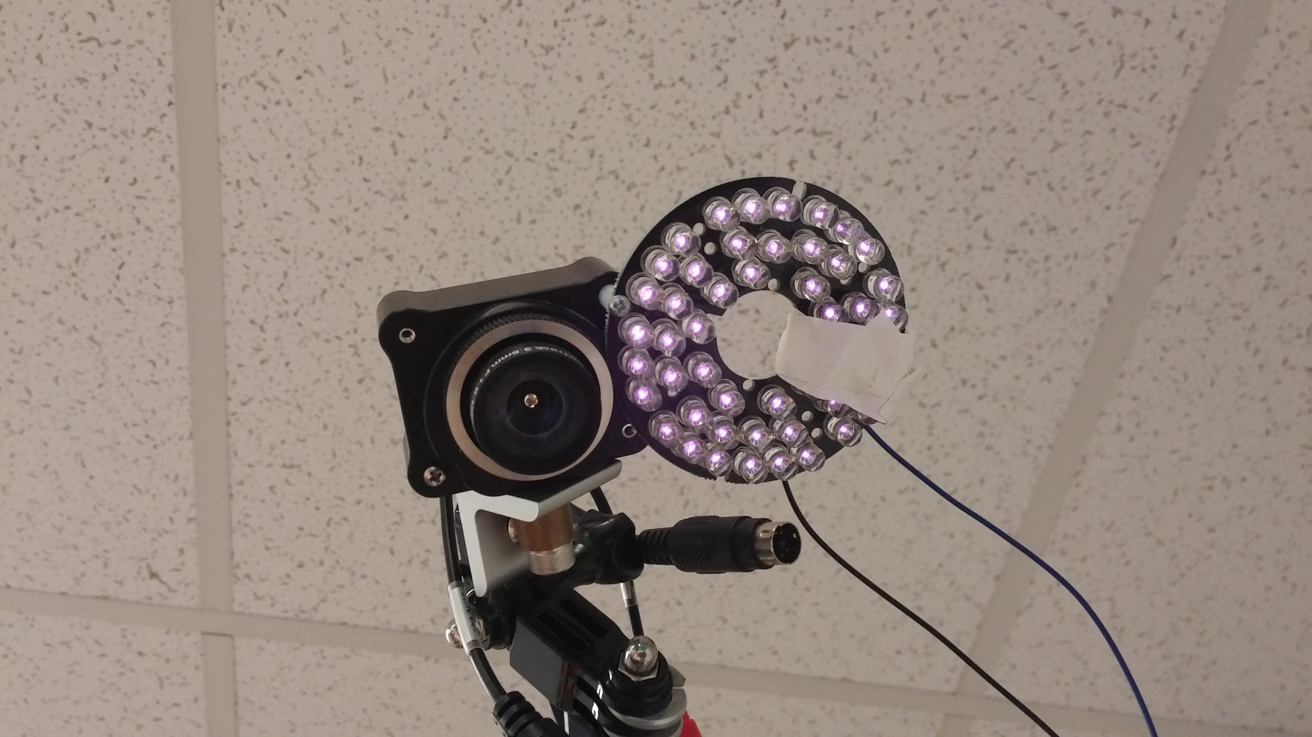
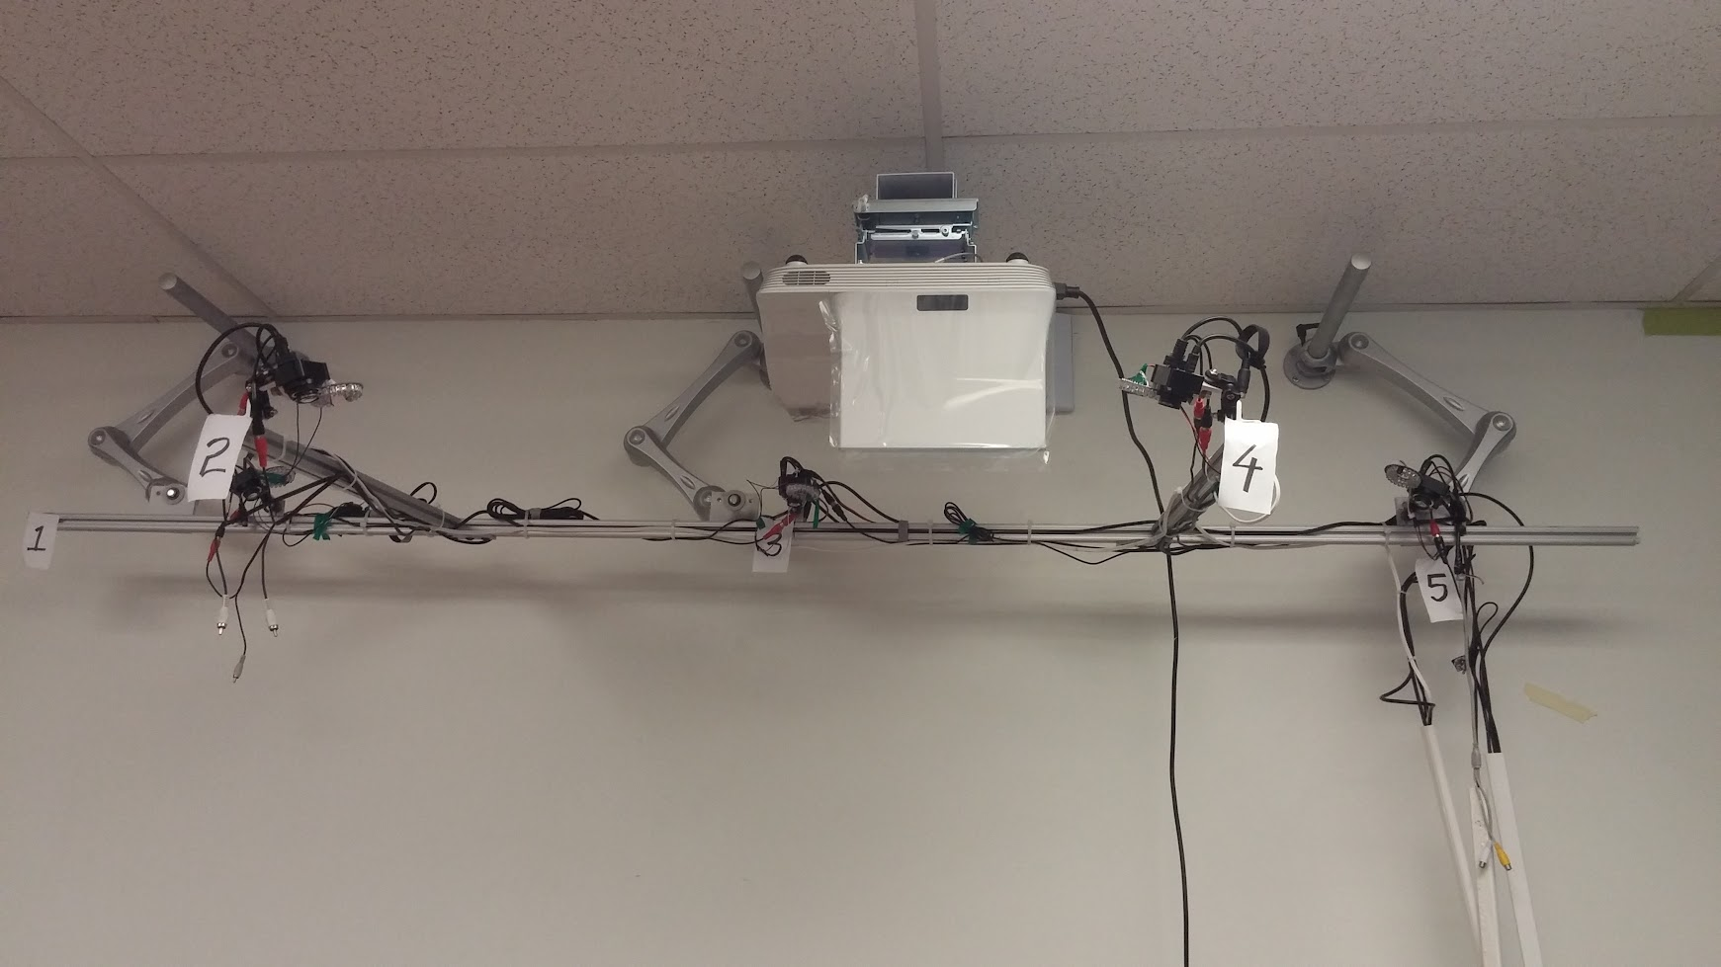
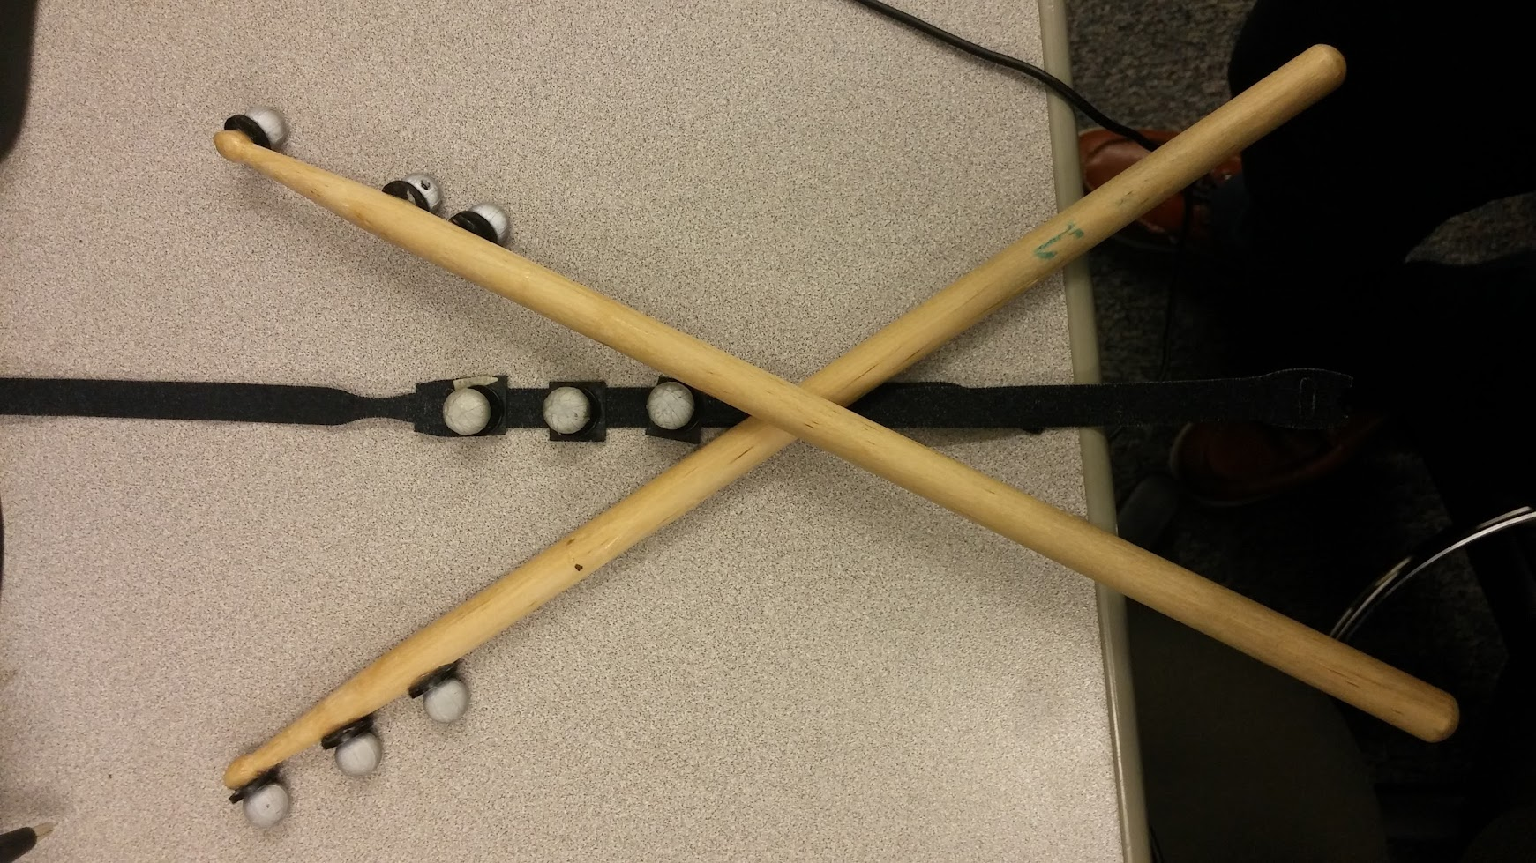
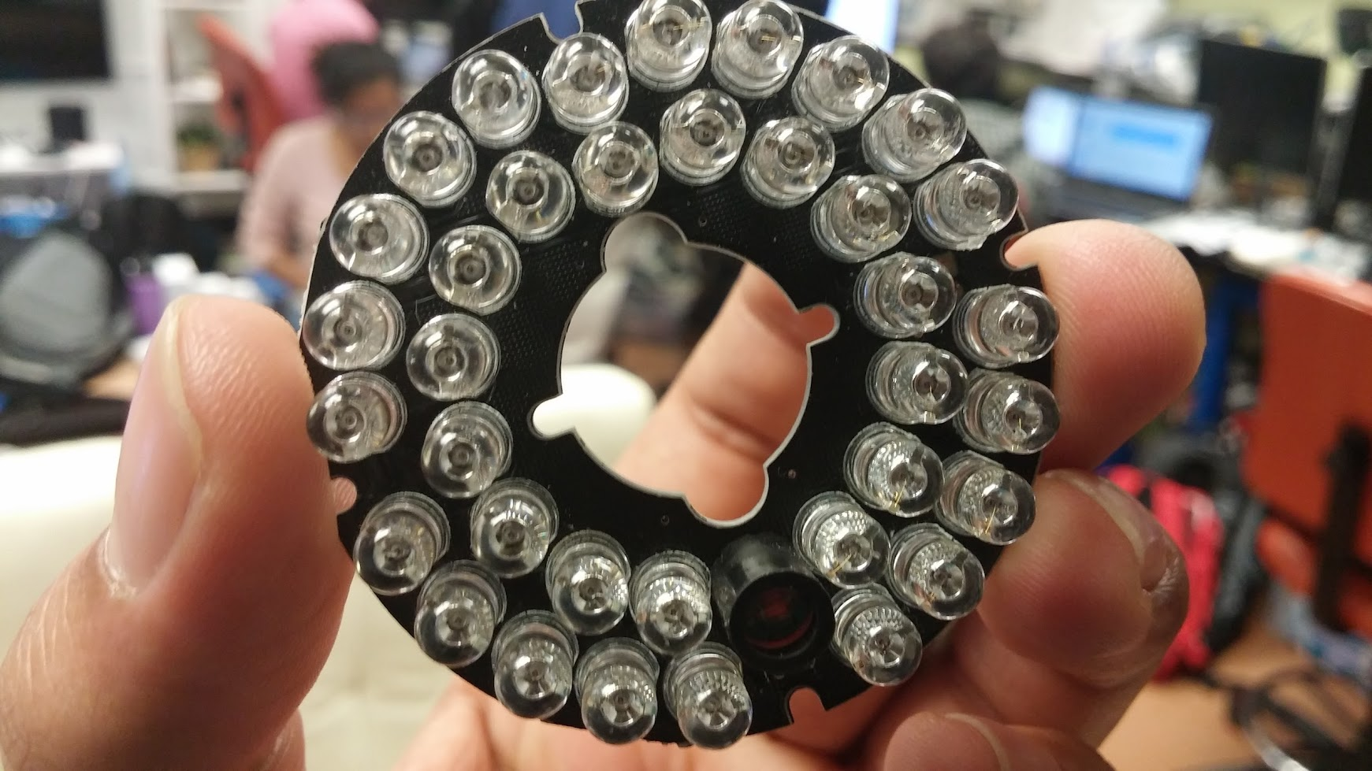
HARDWARE AND MECHANICAL EFFORT
HARWARE :
INFRARED CAMERA SENSORS
IR EMITTER CIRCUITS
OCULUS
MECHANICAL :
STRUCTURE OF THE SYSTEM
CALIBRATION WANDS AND SQUARES
RIGID BODIES

Slide 5
SOFTWARE EFFORT
SOFTWARE:
OPTITRACK MOTIVE
UNITY-3D GAME ENGINE
VRUI [VIRTUAL REALITY USER INTERFACE]
CODE:
AROUND 1000 LINES OF CODE IN C#
CREATED 4 APPLICATIONS – PING PONG, SPACE SHOOTER, VIRTUAL DRUMS

Slide 6
ACCOMPLISHMENTS
Configured a tracking system that can track up to 5 rigid bodies at a time.
Developed 4 games to acquire a good grid over Motive, Unity and C#
Devised algorithms that can track rigid body movements up to 2 mm
Designed a platform to integrate real time motion into almost any application.

